Slide 1
Longest Common Subsequence (LCS)
Given two sequences X and Y
Z is a common subsequence of X and Y if Z is a subsequence of both X and Y
X=< A, B, C, B, D, A, B>
Y=<B, D, C, A, B, A>
One Common Subsequence: <B, C, B>
Longest Common Subsequence (LCS): <B, C, B, A> with size 4
Goal: To find one of the longest common subsequences of a pair of sequences
This is used in comparing between two genetic/protein sequences.

Slide 2
Solutions for Longest Common Subsequence (LCS)
Naïve Approach:
Try all possible solutions and pick the optimal one.
For a string of length n:
Each character can either be included or not in a subsequence.
Since there are n characters, the number of possible subsequences is 2^{n}

Slide 3
Principle of Optimality for LCS Problem
Suppose LCS(X, Y) is the longest common subsequence of X and Y.
If the LCS of X and Y ends in some character c.
Then, the optimal solution for LCS(X, Y) must include the optimal solution for LCS(X', Y'), where X′ and Y′ are the prefixes of X and Y excluding the last character c.
In simpler terms:
The LCS of two strings is built from the LCS of their prefixes.
Every optimal solution is constructed from optimal solutions of smaller subproblems.
Therefore, the principle of optimality holds!

Slide 4
Understanding the Recursive Formula
Let LCS(X, Y, m, n) be the length of the longest common subsequence of two strings: X of length m and Y of length n
There are two cases:
Case 1: If the last characters of X and Y are the same, then that character must be part of the LCS. So, we move both pointers one step back: LCS(X,Y,m,n)=1+LCS(X,Y,m−1,n−1)
Case 2: If the last characters do not match, we have two options:
Ignore the last character of X and compute LCS for X[0…m−2] and Y[0…n−1]
Ignore the last character of Y and compute LCS for X[0…m−1] and Y[0…n−2]
Exp: X = "AGGTAB" , Y = "GXTXAYB" m=6 , n=7 → LCS: "GTAB"
AGGTA GXTXAY
AGGTA GXTXAY

Slide 5

DP solution to solve LCS
j
i
 | “” | G | X | T | X | A | Y | B
“” | 0 | 0 | 0 | 0 | 0 | 0 | 0 | 0
A | 0 | 0 | 0 | 0 | 0 | 1 | 1 | 1
G | 0 | 1 | 1 | 1 | 1 | 1 | 1 | 1
G | 0 | 1 | 1 | 1 | 1 | 1 | 1 | 1
T | 0 | 1 | 1 | 2 | 2 | 2 | 2 | 2
A | 0 | 1 | 1 | 2 | 2 | 3 | 3 | 3
B | 0 | 1 | 1 | 2 | 2 | 3 | 3 | 4
X = "AGGTAB" Y = "GXTXAYB"
The LCS size is 4. To find LCS, backtrack the table.

Slide 6
Backtracking to Find LCS
Start at c[m, n] (bottom-right corner).
If X[i-1] == Y[j-1]: Include X[i-1] in LCS. Then, move diagonally to c[i-1, j-1]
If X[i-1] != Y[j-1]: Move left (c[i, j-1]) if it has a larger value Else, move up (c[i-1, j])
 | “” | G | X | T | X | A | Y | B
“” | 0 | 0 | 0 | 0 | 0 | 0 | 0 | 0
A | 0 | 0 | 0 | 0 | 0 | 1 | 1 | 1
G | 0 | 1 | 1 | 1 | 1 | 1 | 1 | 1
G | 0 | 1 | 1 | 1 | 1 | 1 | 1 | 1
T | 0 | 1 | 1 | 2 | 2 | 2 | 2 | 2
A | 0 | 1 | 1 | 2 | 2 | 3 | 3 | 3
B | 0 | 1 | 1 | 2 | 2 | 3 | 3 | 4
G
T
A
B

Slide 7
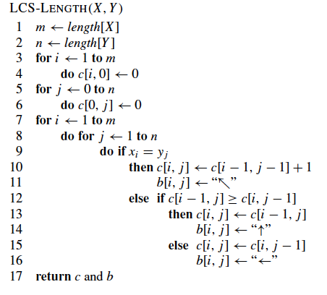
Algorithm for Computing LCS
Time and space complexity: O(nm)

